Slide 1
Figures – Chapter 21

Slide 2
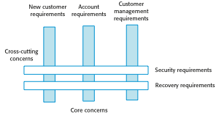
Figure 21.1 Cross-cutting concerns

Slide 3
Figure 21.2 Tangling of buffer management and synchronization code
synchronized void put (SensorRecord rec )
{
// Check that there is space in the buffer; wait if not
if ( numberOfEntries == bufsize)
wait () ;
// Add record at end of buffer
store [back] = new SensorRecord (rec.sensorId, rec.sensorVal) ;
back = back + 1 ;
// If at end of buffer, next entry is at the beginning
if (back == bufsize)
back = 0 ;
numberOfEntries = numberOfEntries + 1 ;
// indicate that buffer is available
notify () ;
} // put

Slide 4
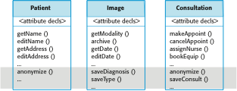
Figure 21.3 Scattering of methods implementing secondary concerns

Slide 5
Figure 21.4 Terminology used in aspect-oriented software engineering
Term | Definition
advice | The code implementing a concern.
aspect | A program abstraction that defines a cross-cutting concern. It includes the definition of a pointcut and the advice associated with that concern.
join point | An event in an executing program where the advice associated with an aspect may be executed.
join point model | The set of events that may be referenced in a pointcut.
pointcut | A statement, included in an aspect, that defines the join points where the associated aspect advice should be executed.
weaving | The incorporation of advice code at the specified join points by an aspect weaver.

Slide 6
Figure 21.5 An authentication aspect
aspect authentication
{ before: call (public void update* (..)) // this is a pointcut {
// this is the advice that should be executed when woven into
// the executing system int tries = 0 ;
string userPassword = Password.Get ( tries ) ; while (tries < 3 && userPassword != thisUser.password ( ) ) { // allow 3 tries to get the password right tries = tries + 1 ; userPassword = Password.Get ( tries ) ; } if (userPassword != thisUser.password ( )) then //if password wrong, assume user has forgotten to logout System.Logout (thisUser.uid) ; }
} // authentication

Slide 7
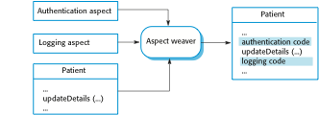
Figure 21.6 Aspect weaving

Slide 8
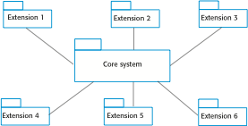
Figure 21.7 Core system with extensions

Slide 9
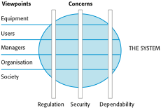
Figure 21.8 Viewpoints and Concerns

Slide 10
Figure 21.9 Viewpoints on an equipment inventory system
1. Emergency service users
1.1 Find a specified type of equipment (e.g., heavy lifting gear)
1.2 View equipment available in a specified store
1.3 Check-out equipment
1.4 Check-in equipment
1.5 Arrange equipment to be transported to emergency
1.6 Submit damage report
1.7 Find store close to emergency
2. Emergency planners
2.1 Find a specified type of equipment
2.2 View equipment available in a specified location
2.3 Check-in/cCheck out equipment from a store
2.4 Move equipment from one store to another
2.6 Order new equipment
3. Maintenance staff
3.1 Check -in/cCheck -out equipment for maintenance
3.2 View equipment available at each store
3.3 Find a specified type of equipment
3.4 View maintenance schedule for an equipment item
3.5 Complete maintenance record for an equipment item
3.6 Show all items in a store requiring maintenance

Slide 11
Figure 21.10 Availability-related requirements for the equipment inventory system
AV.1 There shall be a ‘hot standby’ system available in a location that is geographically well-separated from the principal system.
Rationale: The emergency may affect the principal location of the system.
AV.1.1 All transactions shall be logged at the site of the principal system and at the remote standby site.
Rationale: This allows these transactions to be replayed and the system databases made consistent.
AV.1.2 The system shall send status information to the emergency control room system every five minutes.
Rationale: The operators of the control room system can switch to the hot standby if the principal system is unavailable.

Slide 12
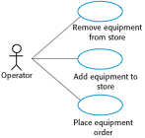
Figure 21.11 Use cases from the inventory management system

Slide 13

Figure 21.12 Extension use cases

Slide 14
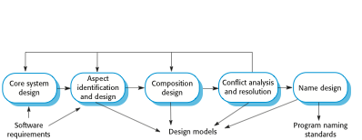
Figure 21.13 A generic aspect-oriented design process

Slide 15
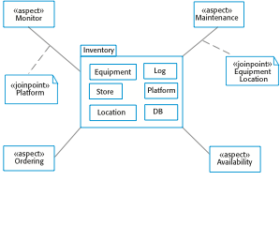
Figure 21.14 An aspect-oriented design model

Slide 16
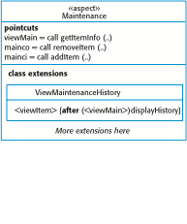
Figure 21.15 Part of a model of an aspect

